Slide 1
Position tracking of soft robot end-effector using estimated Jacobian
Orla Gotthelf, Caleb Fick, Yusra Farhat Ullah

Slide 2
Agenda
The Background
The Gap
The Setup
The Math
The Code
The Demo
The Conclusion
Questions

Slide 3
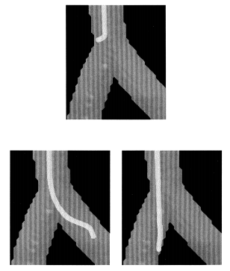
Background
Human endovascular system:
  Unstructured environment, branching points, tortuous anatomy
Presently available
  Rigid and semi-rigid hyper-redundant manipulators that can track arbitrary paths
“Truly soft robots”:
  Challenging modeling due to infinite DOF’s and non-linearity
Catheter being pushed and twisted to enter desired arterial branch under fluoroscopy
[3] Lawton et al. (2000) IJSS
Notes:
Human anatomy such as the human endovascular system is an unstructured, dynamically constrained environment with bifurcations and trifurcations that catheters, robotic or conventional, have to navigate.

Slide 4
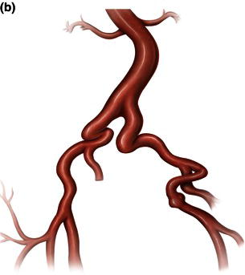
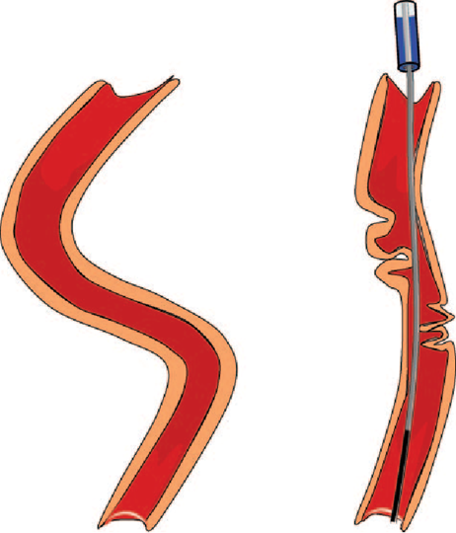
Background
Human endovascular system:
  Unstructured environment, branching points, tortuous anatomy
Presently available
  Rigid and semi-rigid hyper-redundant manipulators that can track arbitrary paths
“Truly soft robots”:
  Challenging modeling due to infinite DOF’s and non-linearity
Tortuous iliac artery [1]
Accordion phenomenon, guidewire stretching vessel wall [2]
[1] Endovascular and Hybrid Therapies, Kpodonu & Bonan
[2] Muller et al. (2008) Circulation
Notes:
It becomes even more difficult when the pathways are tortuous with kinks and curves that require a lot of deformability.
The compliant nature of soft robots is ideally suited to this task, but its modeling is challenging due to infinite DOF’s and the high degree of non-linearity involved. Previous work in the field has approached the approximate analytical kinematic and dynamic modeling of continuum robots in multiple ways, which are listed comprehensively in [1]. These approximations are based on heavy simplification and require increasingly higher computation power for increasing complexity. Furthermore, unknown environmental factors can account for an inaccurate analytical model approximation. More recently, model-less [2] or kinematic-free control [3] has been used to control the position of a robot without using an explicit model. Wang et al. [4] have experimentally shown that model-free control is more accurate as compared to model-based control in robotic catheters.
Snake-like or continuum robots used for endovascular or intravascular procedures are not the true definition of a soft robot, i.e. using soft deformable materials. They are various versions of hyper redundant and hard continuum robots. Then, there are soft robots, such as the Stanford Vine which have not been shown to be used endovascularly.

Slide 5
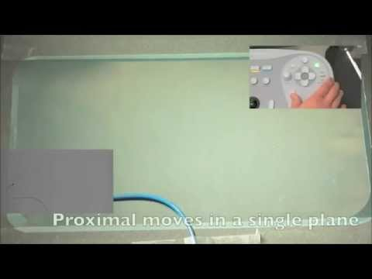
Background
Human endovascular system:
  Unstructured environment, branching points, tortuous anatomy
Presently available
  Rigid and semi-rigid hyper-redundant manipulators that can track arbitrary paths
“Truly soft robots”:
  Challenging modeling due to infinite DOF’s and non-linearity
Notes:
Presently available manipulators are rigid or semi-rigid continuum or hyper-redundant robots. They are not truly soft and so pose a considerable risk to delicate human anatomy in constrained spaces.
That’s where soft robots step in. But the control of soft robots is limited by the challenge of deriving the inverse kinematics. Closed-form analytical solutions are not only complicated, but also still remain, at best, an approximation of the non-linearities of soft bodies.

Slide 6
The gap and how we address it
Gap:
Model-less [4] or kinematic-free control [5] shown to be more accurate [6]
FNN based learned model for 2-cable driven soft robots[7]
FEM-initiated learning of Jacobian in hydraulic[8]
No experiments for 3-cable driven soft arm
Research objective:
Numerical Jacobian estimation using workspace exploration for visual servoing of robot tip position
[4] Yip & Camarillo (2016) IEEE RAL
[5] Kormushev et al. (2015) IEEE International Conference on Intelligent Robots and Systems
[6] Wang et al. (2018) Int. J. Comput. Assist. Radiol. Surgery
[7] Giorelli et al. (2013) IEEE Int. Conf. Intell. Robot. Syst.
[8] Lee et al. (2017) Soft Robotics
Notes:
To address that, there has been recent research in the field using kinematic free control.
Kormushev et al were the first to suggest kinematic free control in a rigid planar robot, whereas model-less control based on inverse jacobian has been used by yip and camarillo to control a pullwire driven continuum robot. This moves in a 2D plane. Wang et al compared the accuracy of conventional analytical and kinematic-free free control and found the latter to be more accurate for robotic catheters, again not truly soft.
Specifically, in soft robots Giorelli et al employed a feed-forward neural network based learning of the global controller of a 2-cable driven continuum robot which uses an analytical model for initiating the learning.
Lee et al used a finite element model to initiate the online learning of the inverse jacobian for a soft arm but in the same work they have shown initiation in the workspace to be a superior method
This list is by no means exhaustive but we couldn’t find any experiments on a 3-cable driven soft arm with no backbone using jacobian estimation based purely on workspace exploration
Our research aims to address this gap by determining how accurately the tip positions of a three-cable driven soft arm can be mapped to cable lengthn as a non-parametric Jacobian learned from physical taskspace exploration.
To achieve this objective, our aims were to design and build a 3-cable driven soft arm with a position tracking system, estimate the numerical Jacobian mapping end-effector positions and cable actuation, and implement the Jacobian estimation in an algorithm for achieving desired end-
effector positions
M. C. Yip and D. B. Camarillo, “Model-less Hybrid Position/Force control: A Minimalist Approach for Continuum Manipulators in Unknown, Constrained Environments,” IEEE Robot. Autom. Lett., vol. 1, no. 2, pp. 844–851, 2016.
K.-H. Lee et al., “Nonparametric Online Learning Control for Soft Continuum Robot: An Enabling Technique for Effective Endoscopic Navigation,” Soft Robot., vol. 4, no. 4, p. soro.2016.0065, 2017.
Liu et al. Iterative Jacobian-Based Inverse Kinematics and Open-Loop Control of an MRI-Guided Magnetically Actuated Steerable Catheter System
IEEE/ASME TRANSACTIONS ON MECHATRONICS, VOL. 22, NO. 4, AUGUST 2017

Slide 7
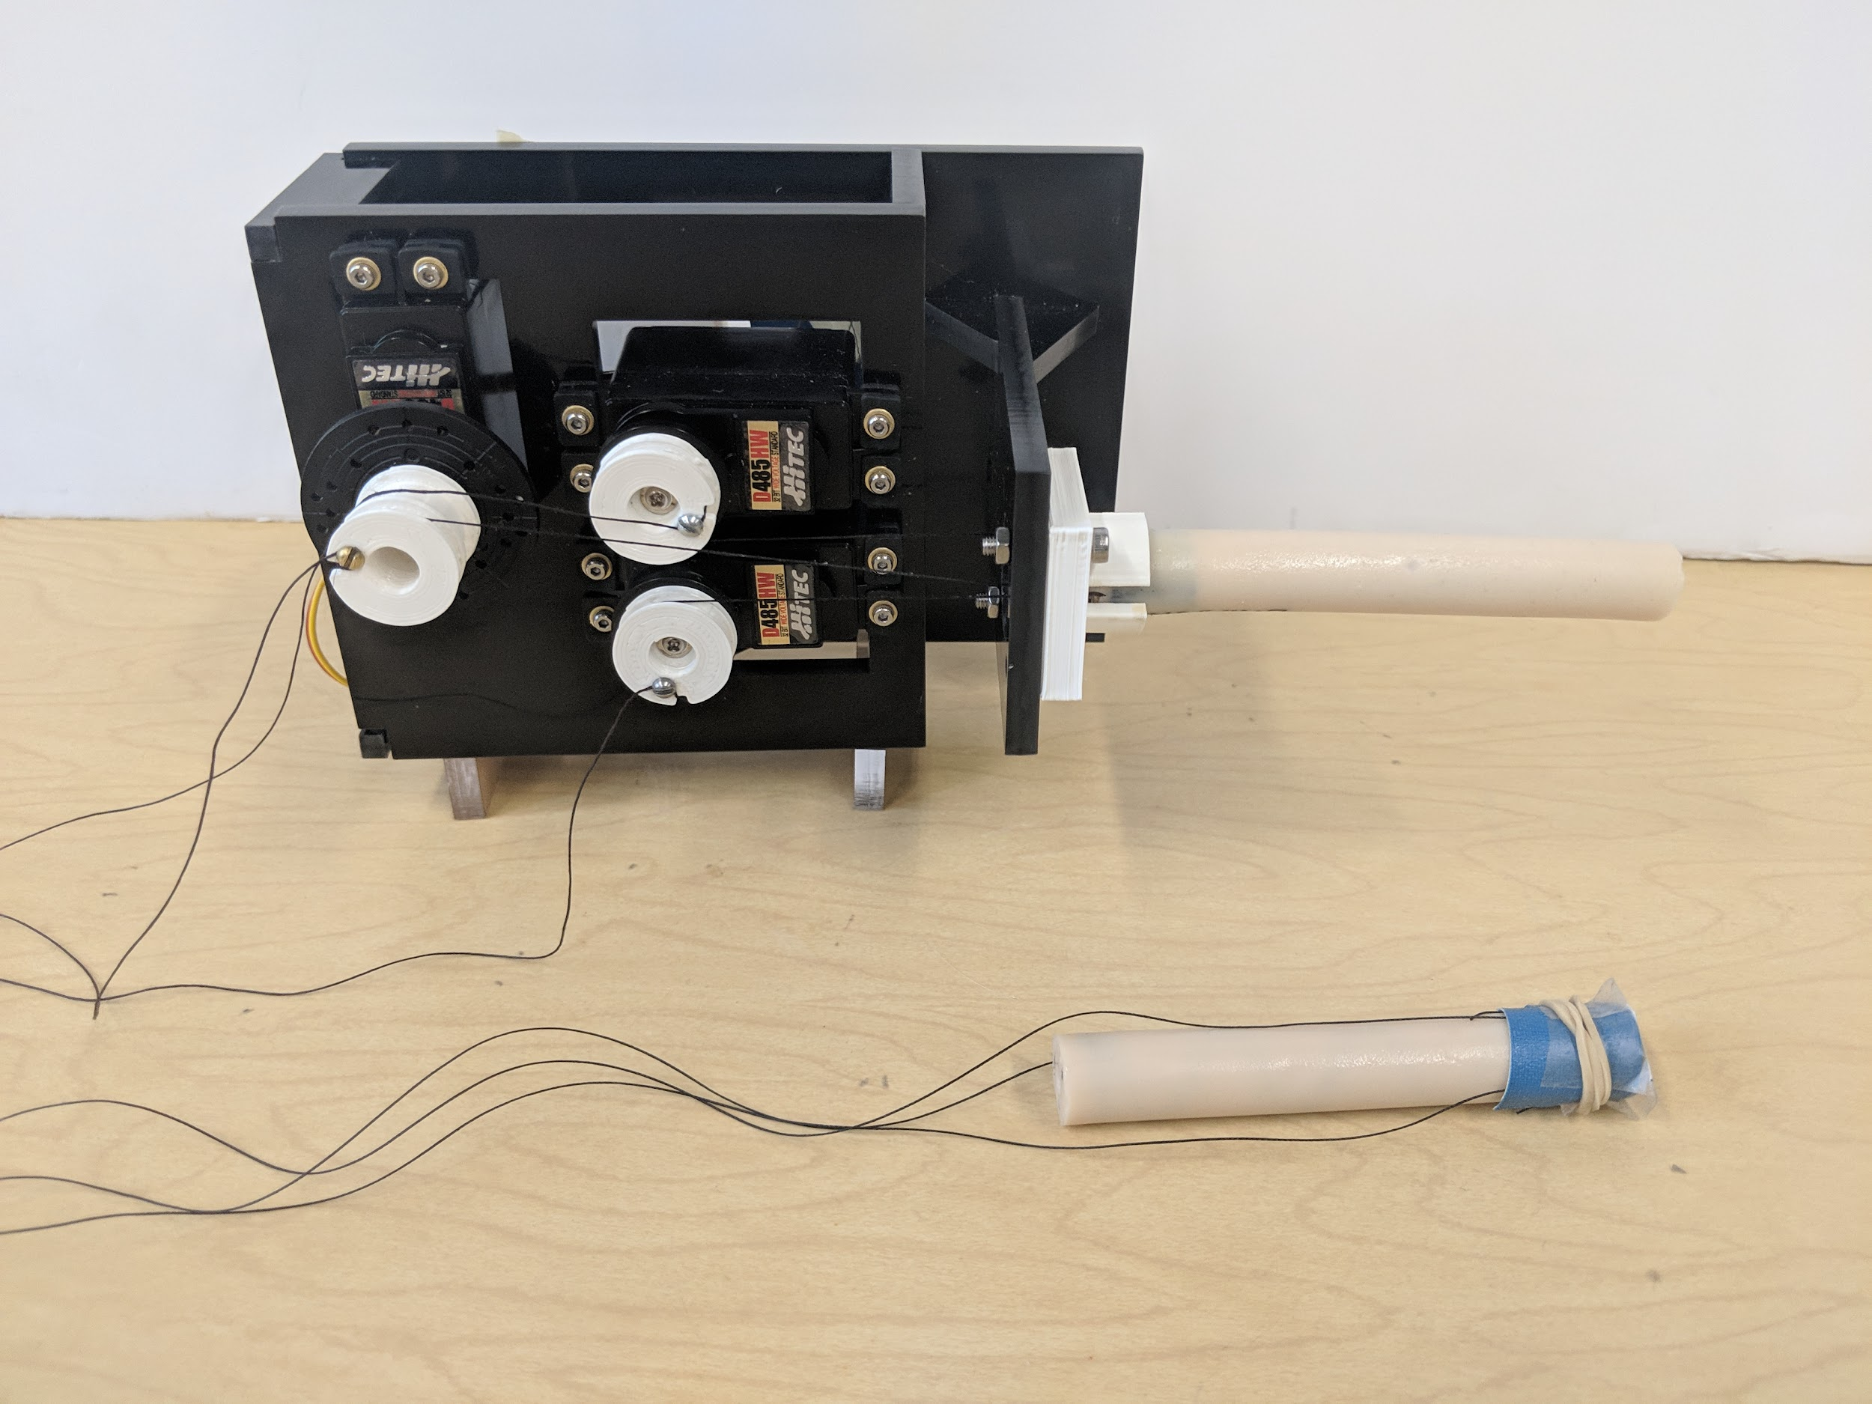
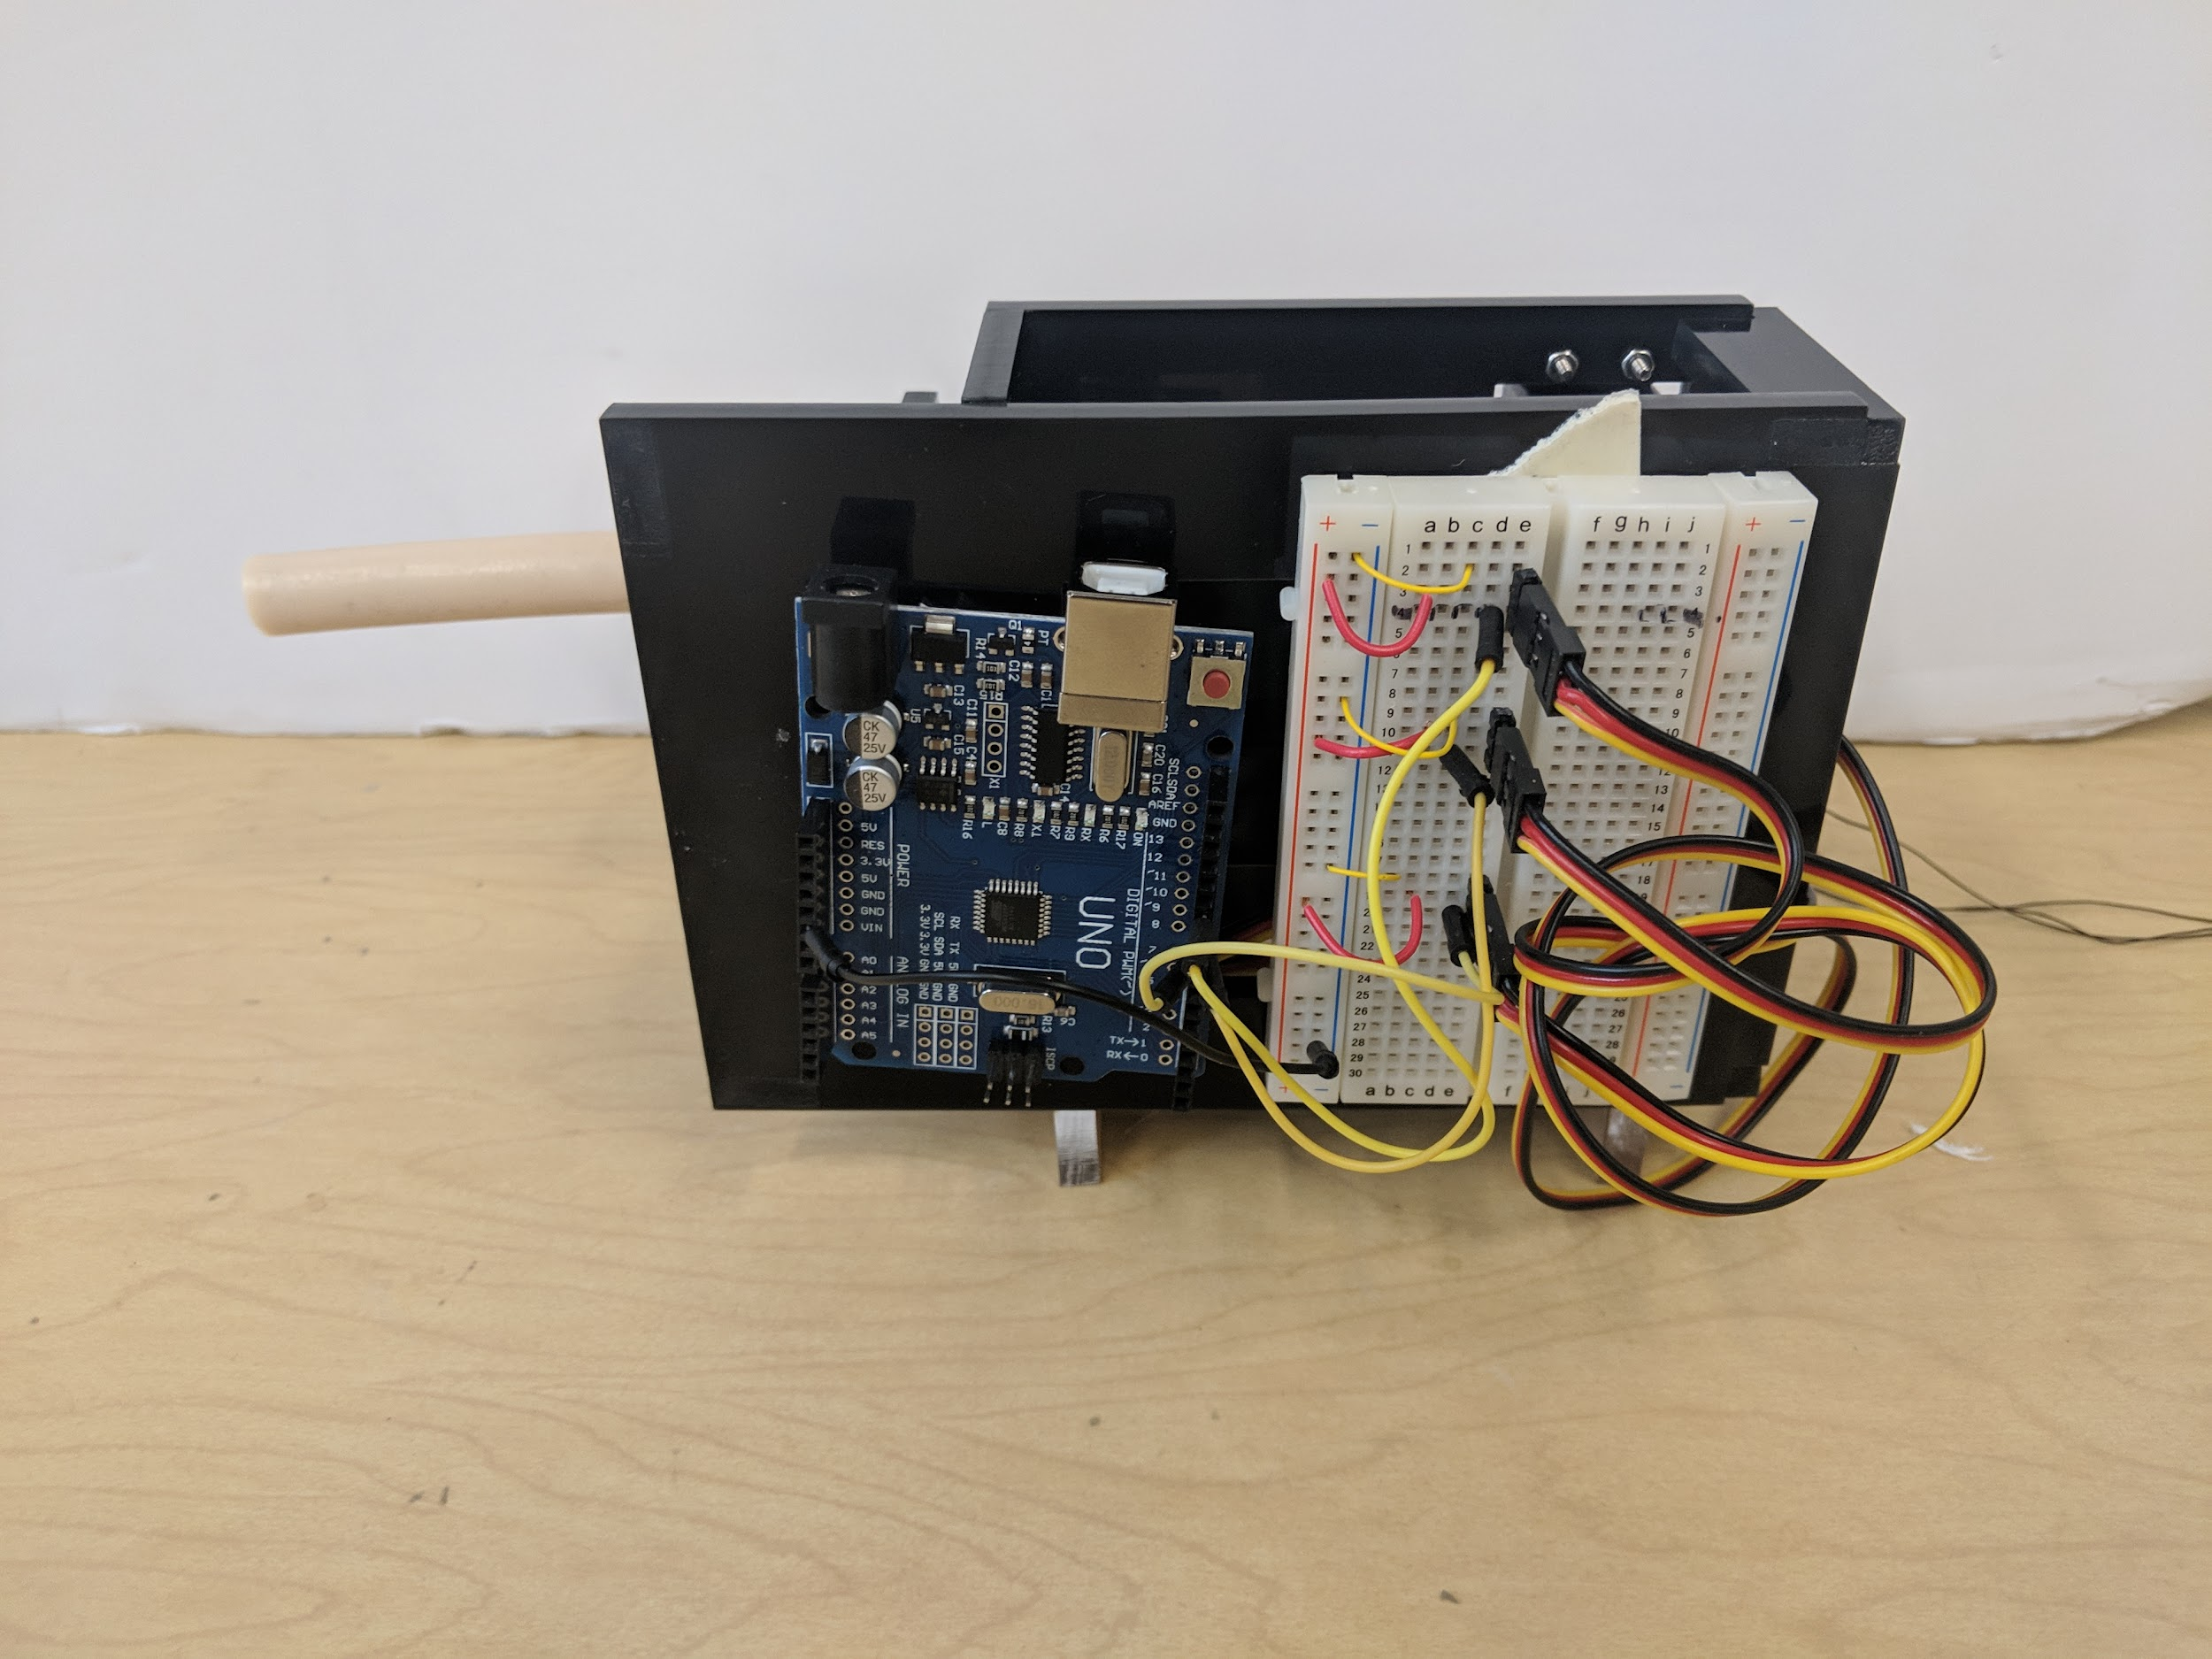
Experimental Setup
Embedded
Robot Arm:
Polyurethane soft body
3 cables - External and Embedded
The servos:
Three D485HW 32 Bit servos
Individually control cables to move End-Effector
Arduino serial communication with python
Webcam:
OpenCV to monitor End-Effector position in 2D pixel space
External
Notes:
Open cv is implemented in python which passes information to the arduino via serial communication, controlling our servos

Slide 8

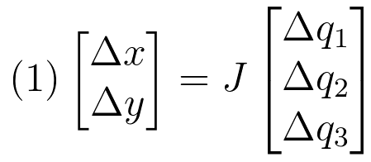
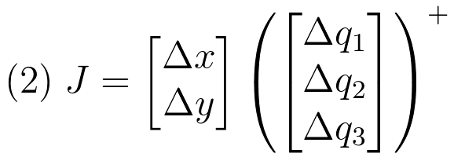
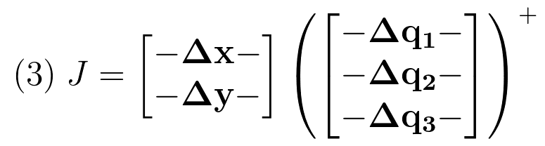
Jacobian estimation using least squares
Where:
p = position vector
q = servo position vector
Δx, Δy = change in pixel position
Δq’s = change in servo-positions (microseconds)
J = 2x3 Jacobian

Slide 9
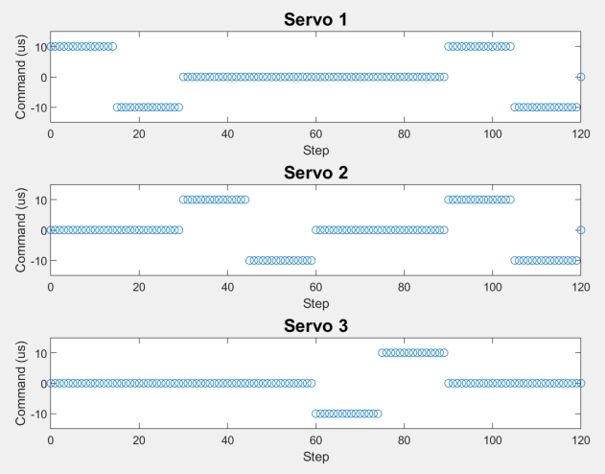
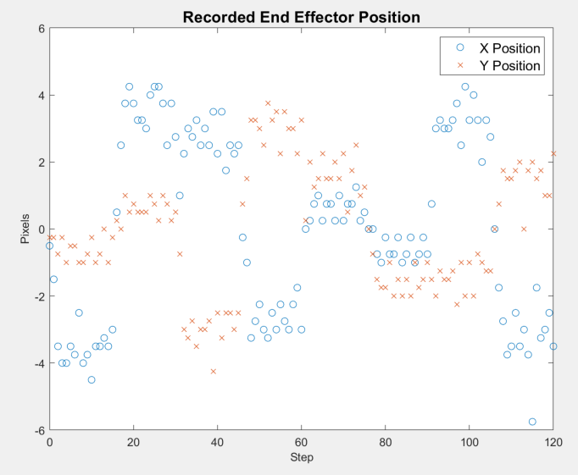
Finding the Initial Jacobian

Slide 10
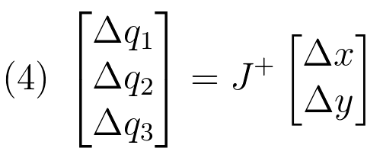
Controlling the Robot and Updating the Jacobian

Slide 11

Demo

Slide 12
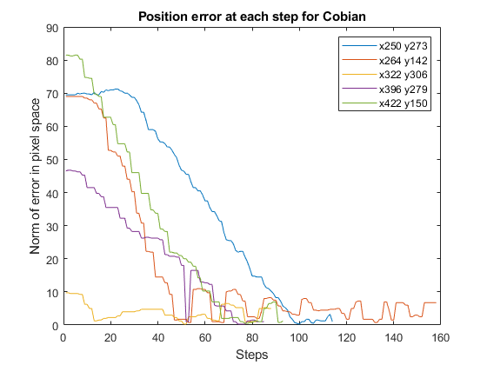
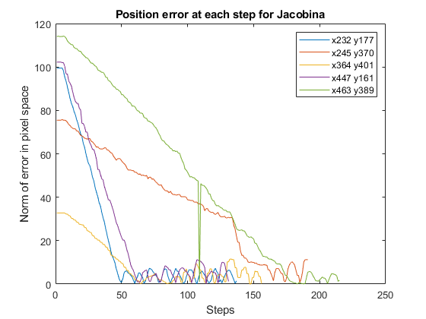
Results
Embedded Strings
External Strings

Slide 13
Conclusion and Future Work
Conclusion:
Local Jacobian gives a reliable estimate of robot dynamics
Jacobian accounts for all non-linearities including string tautness, manufacturing errors, broken servo
Model-free control is the future
Future work:
Vessel sized robot arm
Growth as additional DOF (remove kinematic lock)
Pressure-driven arm
Connected as end-effector to soft catheter robot

Slide 14
Questions

Slide 15
Appendix
The non-parametric numerical Jacobian method has been used to control a 2-cable driven soft arm moving in 2D space [5], and a hydraulically actuated 3-chamber soft arm for endoscopy [6].
M. C. Yip and D. B. Camarillo, “Model-less Hybrid Position/Force control: A Minimalist Approach for Continuum Manipulators in Unknown, Constrained Environments,” IEEE Robot. Autom. Lett., vol. 1, no. 2, pp. 844–851, 2016.
K.-H. Lee et al., “Nonparametric Online Learning Control for Soft Continuum Robot: An Enabling Technique for Effective Endoscopic Navigation,” Soft Robot., vol. 4, no. 4, p. soro.2016.0065, 2017.
Liu et al. Iterative Jacobian-Based Inverse Kinematics and Open-Loop Control of an MRI-Guided Magnetically Actuated Steerable Catheter System
IEEE/ASME TRANSACTIONS ON MECHATRONICS, VOL. 22, NO. 4, AUGUST 2017

